Slide 1

Blockchain Based Crowdfunding Platform
Submitted to, Submitted by,
Shammi Akhtar Bidita Sarkar Diba(20101016)
Assistant Professor MD. Mahmudur Rahman(20101009)
Dept of CSE, UAP Jayonto Dutta Plabon(20101022)
August 1, 2022

Slide 2

Contents Of Presentation
Questionnaires: A special-purpose document that allows the analyst to collect information and opinions from respondents.
Feasibility Analysis: It assesses whether a proposed project is both legally and technically feasible, as well as economically justified. Feasibility analysis also identifies the important risks associated with the project that must be managed if the project is approved.

Slide 3
Questionnaire Types
Open-ended question – A question that allows the interviewee to respond in any way that seems appropriate. It allows someone to give a free-form answer.
Closed-ended question – A question that restricts answers to either specific choices or short, direct responses. Questions can be answered with “Yes” or “No,” or they have a limited set of possible answers.

Slide 4
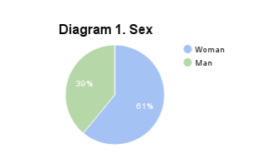
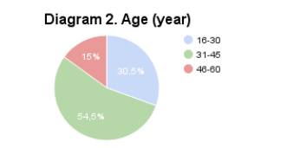
Questionnaires for project

Slide 5
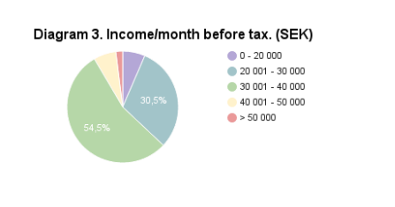
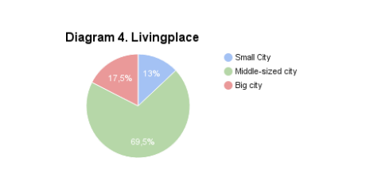
Questionnaires for project

Slide 6
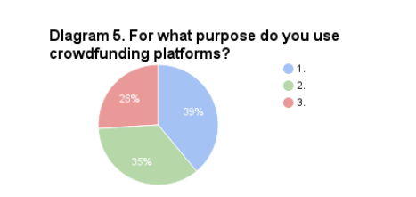
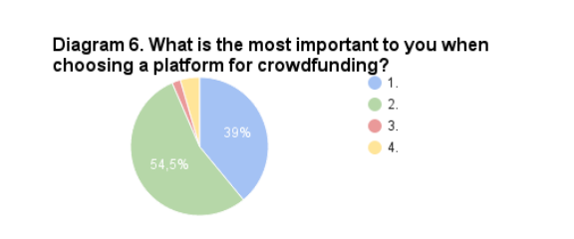
Questionnaires for project
Explanation of the numbers in figure 5:
To fund a newly started project/company.
Start a donation.
To finance an investment.
Explanation for the numbers in figure 6:
Focus on a particular topic or industry.
Large and well-known.
Focus on a particular geographical area.
Donation based.

Slide 7
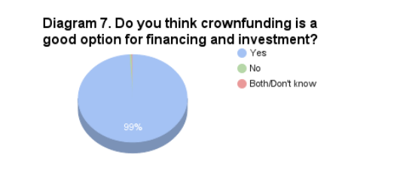
Questionnaires for project

Slide 8

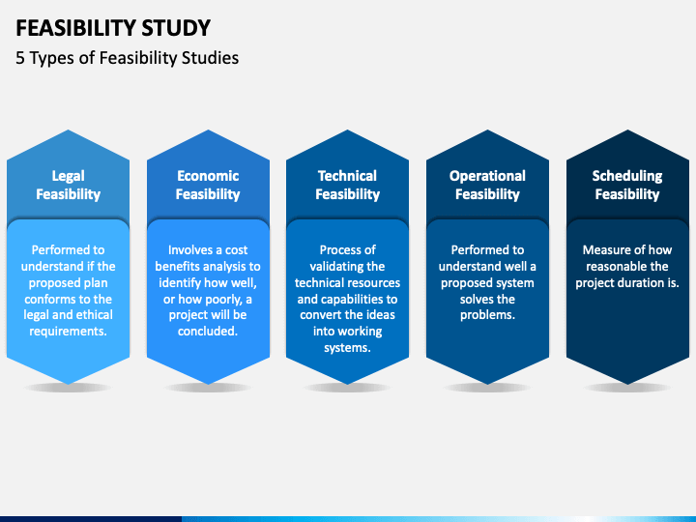
Feasibility Analysis

Slide 9
Technical Feasibility Analysis
Familiarity with application: We have knowledge of business domain. We are understanding the improvements. We have also recognized the pitfalls and bad ideas of the project.
Familiarity with technology: Blockchain technology is new to this organization. But this technology is not a new technology. People have built projects based on this technology. We don’t need further any extension of existing firm right now.
Project size: Number of people, time, and features.
For our project number of people = 12, time = 1.1 year.
Compatibility: The system is not built in a vacuum. It is integrated with current systems and data.

Slide 10
Economic Feasibility
It is evaluating the effectiveness of candidate system by using cost/benefit analysis method.
It demonstrates the net benefit from the candidate system in terms of benefits and costs to the organization.
The main aim of Economic Feasibility Analysis (EFS) is to estimate the economic requirements of candidate system before investments funds are committed to proposal.
It prefers the alternative which will maximize the net worth of organization by earliest and highest return of funds along with lowest level of risk involved in developing the candidate system.

Slide 11
 |  |  | Year 0 | Year 1 | Year 2 | Year 3 | Year 4 | Total
Benefits |  | Percentage from Users | 0 | 150000 | 325000 | 555000 | 680000
 |  | Transaction Fees | 0 | 20000 | 55000 | 75000 | 98000
 |  | Advertisement | 0 | 50000 | 100000 | 130000 | 152000
 |  | Total Benefits | 0 | 220000 | 480000 | 760000 | 930000 | 2390000
 | Development Costs | System and Hardware | 375000 | 0 | 0 | 0 | 0
 |  | Development Labor | 250000 | 0 | 0 | 0 | 0
 |  | Advertisement | 120000 | 0 | 0 | 0 | 0
 |  | Total Developments Cost | 745000 | 0 | 0 | 0 | 0 | 745000
 | Operational Costs | Operational Labor | 0 | 60000 | 70000 | 80000 | 90000
 |  | System, Hardware and license | 0 | 15000 | 18000 | 20000 | 22000
 |  | Total Operational Cost | 0 | 75000 | 98000 | 100000 | 112000 | 385000
 |  | Total Costs | 745000 | 75000 | 98000 | 100000 | 112000 | 1130000
Net Benefits |  |  | (745000) | 145000 | 382000 | 660000 | 818000
Cumulative net Benefits |  |  | (745000) | (600000) | (218000) | 442000 | 1260000
Costs

Slide 12


Cost Benefit Analysis
Return of Investment (ROI) = $\frac{\text{Total} \text{Benefits}\text{ – }\text{Total} \text{Costs}}{Total Costs}$
Return of Investment (ROI) = $\frac{\text{2390000 }\text{–}\text{1130000 }}{\text{1130000 }}$
Return of Investment (ROI) = 1.115%
Number of
Years of
Negative
cash flow
Break Event Point (BEP) =
+ $\frac{That years net cash flow−That years cumulative cash flow }{That years net cash flow}$
Break Event Point (BEP) = 2 + $\frac{660000−442000}{660000}$
Break Event Point (BEP) = 2 + 0.33
Break Event Point (BEP) = 2 .33 Years

Slide 13

Cost Benefit Analysis
 | Year 0 | Year 1 | Year 2 | Year 3 | Year 4 | Total
Total Costs | 745000 | 75000 | 98000 | 100000 | 112000 | 1130000
Present Value of Costs | 745000 | 68181.818 | 80991.735 | 75131.480 | 76497.507 | 1045802.54
Total Benefits | 0 | 220000 | 480000 | 760000 | 930000 | 2390000
Present Value of Benefits |  | 200000 | 396694.214 | 570999.2487 | 635202.513 | 1802895.976
Rate of Return 10%
NPV = $\sum{PV of Benefits}$ - $\sum{PV of Costs}$
NPV = 1802895.976 - 1045802.54
NPV = 757093.4357

Slide 14
legal Feasibility
Legal feasibility is the study to know if the proposed project confirm the legal and ethical requirements.
It is important that the project or business is following the requirements needed to start a business or a project including business licenses, certificates, copyrights, business insurance, tax number, health and safety measures and many more.
There are some things to consider in legal feasibility study including ethical issues and some social issues. These issues are the privacy, nepotism and accountability.

Slide 15
Operational Feasibility
It determines whether the system is operating effectively once it is developed and implemented.
It ensures that the management should support the proposed system and its working feasible in the current organizational environment.
It analyzes whether the users will be affected and they accept the modified or new business methods that affect the possible system benefits.
It also ensures that the computer resources and network architecture of candidate system are workable.

Slide 16
Schedule Feasibility
In Schedule Feasibility Study mainly timelines/deadlines is analyzed for proposed project which includes how many times teams will take to complete final project which has a great impact on the organization as purpose of project may fail if it can’t be completed on time.
It ensures that the project should be completed within given time constraint or schedule.
It also verifies and validates whether the deadlines of project are reasonable or not.

Slide 17
THANKS FOR YOUR ATTENTION

